Slide 1
Predicting Future Sales of Products
Felipe Rodriguez and Christopher Botts
Notes:
Hello and thank you for taking the time to speak with us. Today we will be going over our work in Predicting Sales of our products. -Felipe

Slide 2
Agenda
Initial Request
Data Overview
Data Preliminary Analysis
Modeling
Interpretation
Recommendation
Notes:
This will be our agenda for today. We will be going over the:
Initial Request – This will cover some of requirements established for the project
Data Overview – We will be talking about what the data contains
Data Preliminary analysis – Will included our initial research done and data cleansing
Modeling – this will have the steps conducted for modeling
Interpretation – will cover the finding of the model
Recommendation – final thoughts of our findings and recommendations for the group
-Felipe

Slide 3
Initial Request
Electronics Department
Analyze Sales
Determine Profitability
Predict Future Sales
Notes:
The initial request came in from the electronic departments. Their ask was to analyze their sales and determine the profitability of their products. In addition to this, they are wanting to predict future sales and determine how the products will behave. -Felipe
Growth in the electronics sector is primarily driven by innovation and accelerated by consumer spending on a global level (Beers, 2022).

Slide 4

Data Overview
Data Source: Kaggle
Full year of Electronic Sales
Various Product
Computers, Phones, Headphone, Batteries, etc.
Categories to be analyzed
Margin and Product
Notes:
The data from the Electonic division contains a full year's worth of data of Electonic sales. This data includes information such as products, categories, address, margin, and cost. The data provided contains various products as well which include computers, phones, headphones and batteries. With the data provided, the plan is analyze products and margins. -Felipe

Slide 5
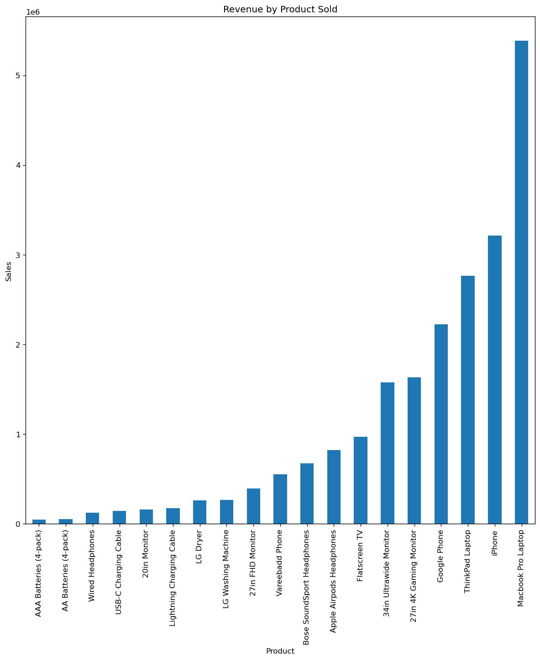
Data Overview
Large range in revenue across products

Slide 6

Data Preliminary Analysis Initial Data Prep
Feature Reduction
Unclean features, such as 'catégorie'
Features that do not contribute to the model, such as sale ID and EAN
Features irrelevant to business question, such as 'purchase address'
Column Formatting – Datetime
Allows for Time Series Analysis
Notes:
In our preliminary analysis, our first step was to prep the data for the model, as well for research. The first item we tackled was feature reduction. This involved removing the features we did not need for model or analysis. For the initial analysis we kept most of the features, but for the model creation we removed all columns except product and margin. In addition to this, we conducted some formatting of the time stamp column into datetime format, this was going to help with our time series analysis. -Felipe

Slide 7
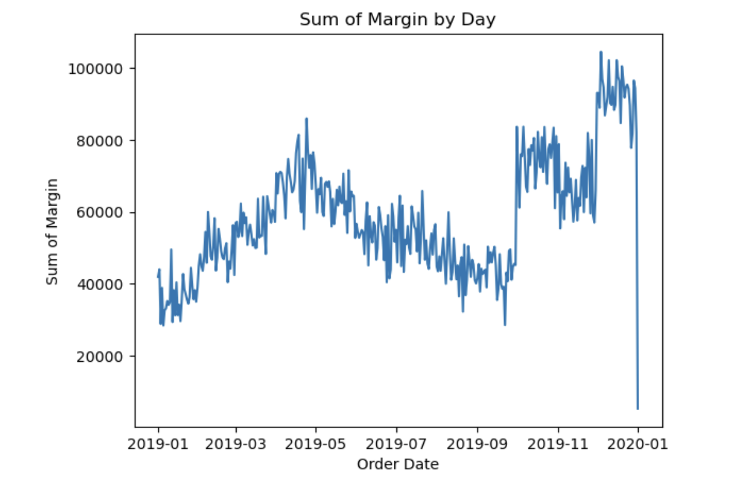
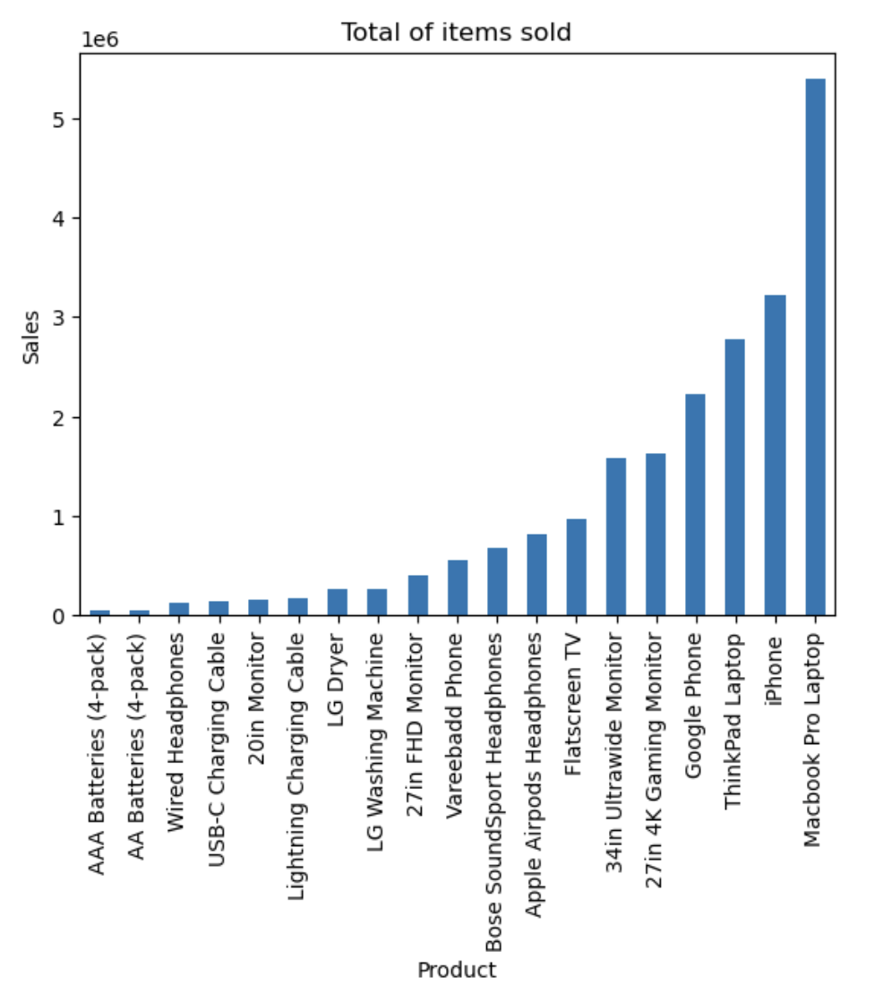
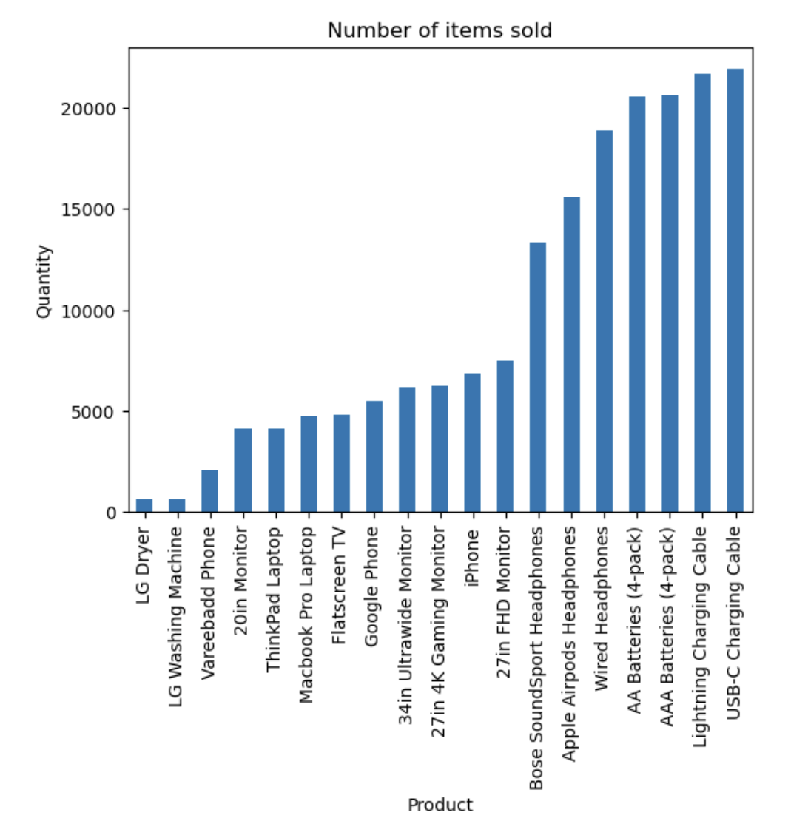
Data Preliminary Analysis
Distributional Analysis
Quantity Sold
Total Margin
Notes:
After our data was prepped and cleansed, our preliminary analysis first looked at the distribution of sales of the products. The two graphs we looked at were the quantity of items sold and the total margin of the items sold. This two charts showed that although some of the items that made the most money did not sell as frequently and vice verse, the items that sold most frequently had the lower sales since they are prices less. The next item analyzed was showcasing margin over time. The margin is seen declining and rising over time. Some of the factors for these changes in sales could be seasonal trends as well as the introduction of products at certain times. There is also a drop in data which explains why the values approach 0 at the end. -Felipe

Slide 8
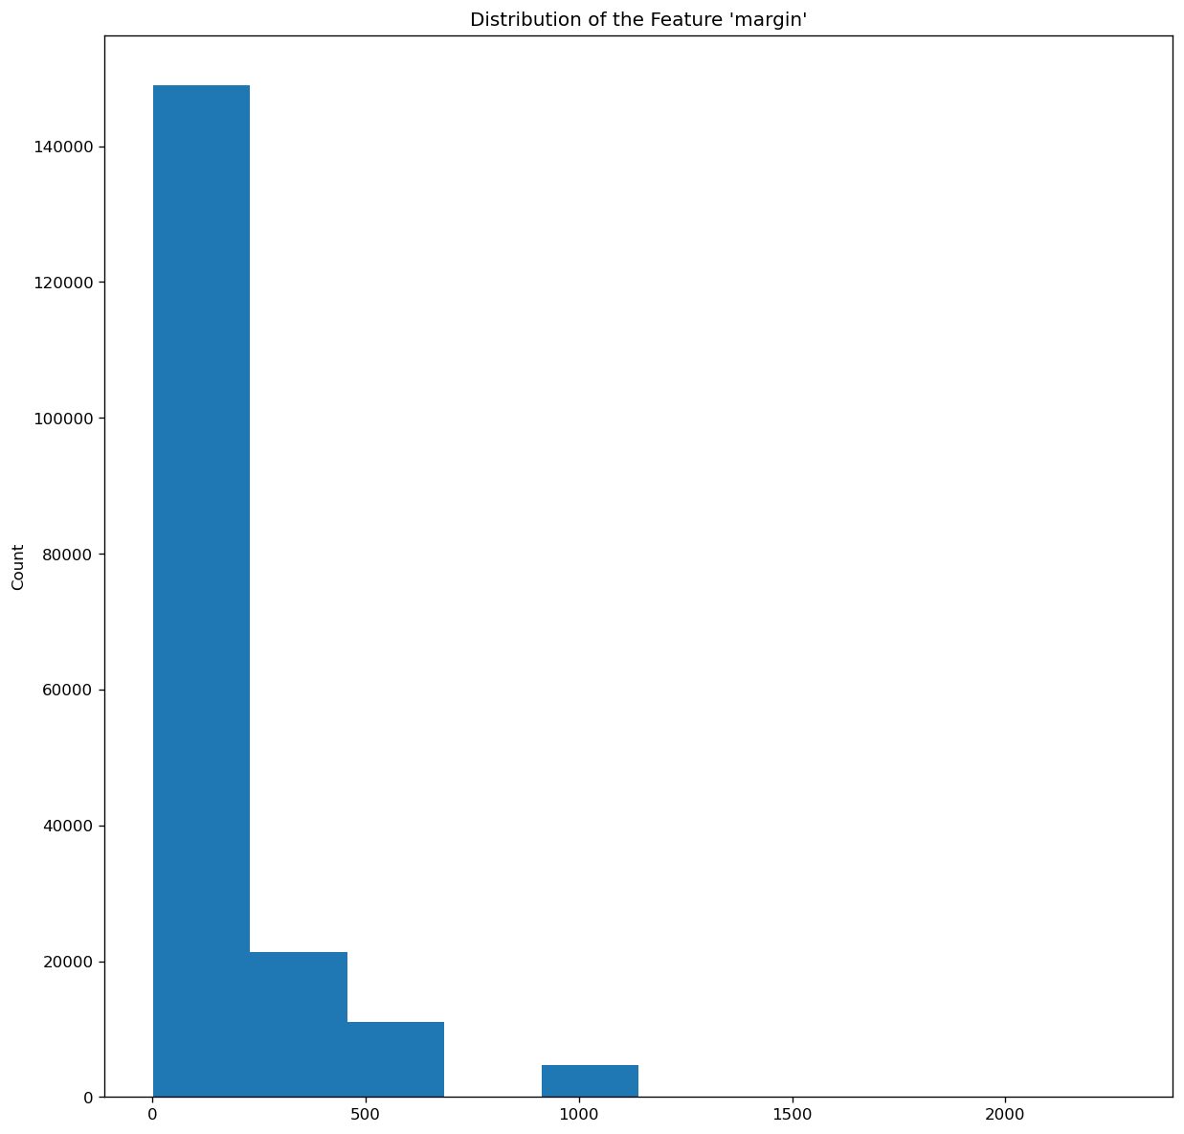
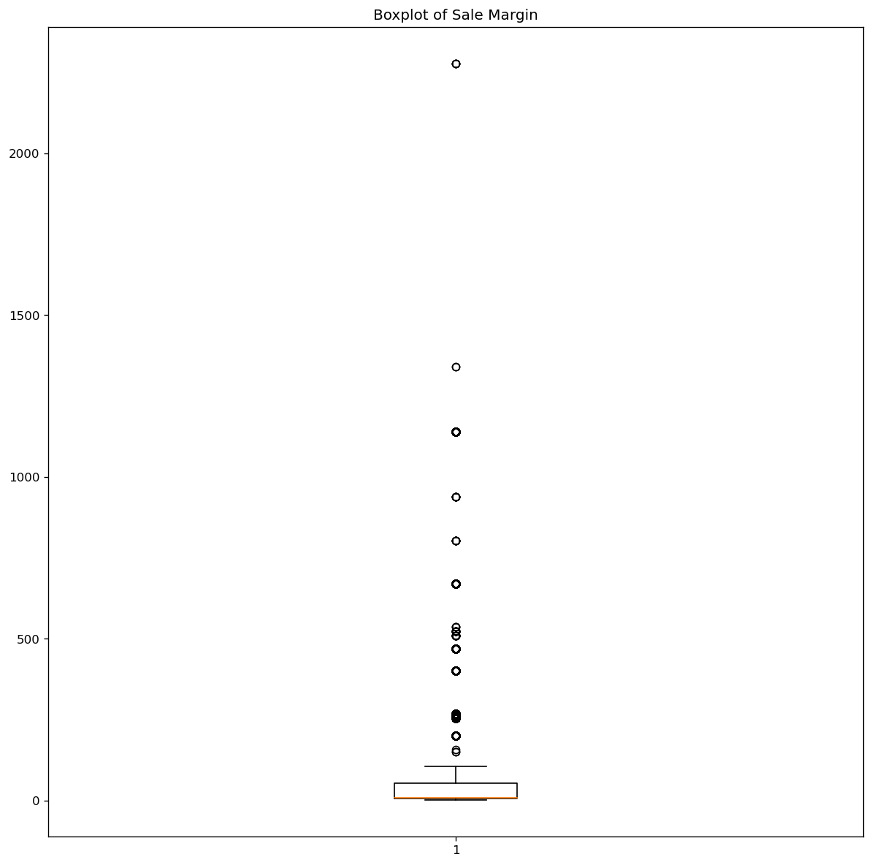
Data Preliminary Analysis
Distribution
High skew in target feature
Dataset split into three
Low margin
High margin
Very high margin
Image 2. Distribution of unmodified target feature
Image 3. Outliers in target feature

Slide 9
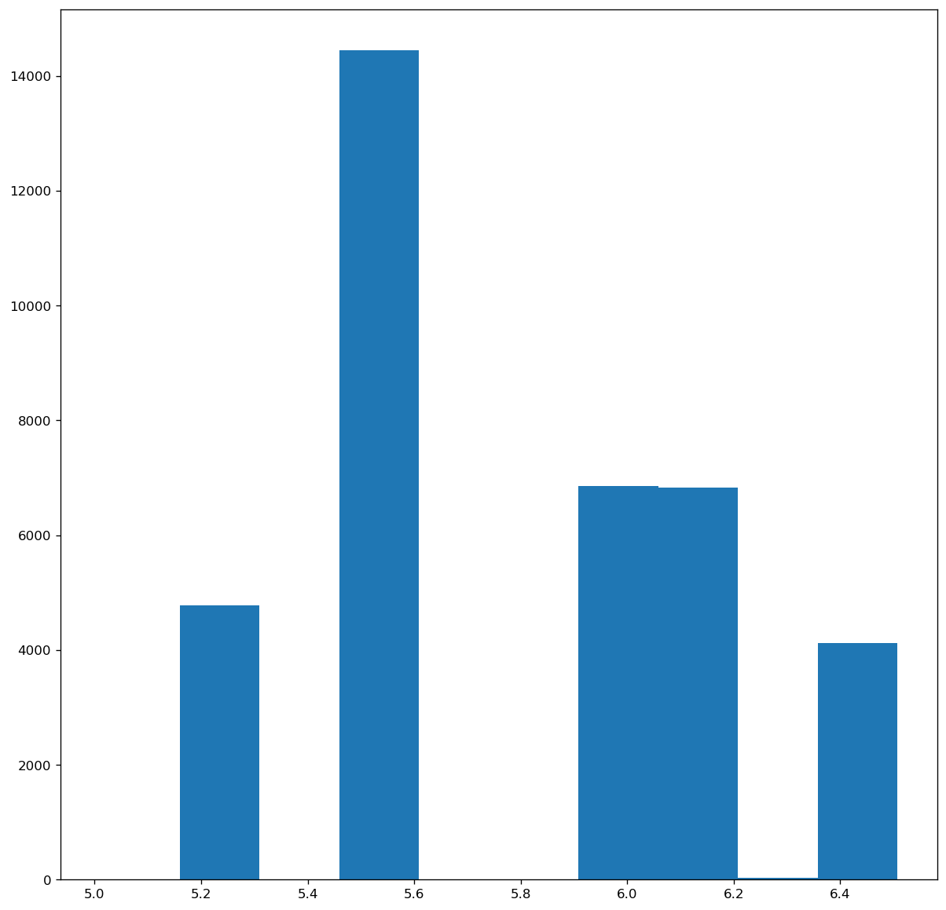
Data Preliminary Analysis More Data Prep
To use data in the model:
Grouped sales by date to utilize in Time Series Analysis
Eliminated the final day of data because it was not complete
Mitigate positive skew on datasets
Log10 transformation effectively transformed data to a normal distribution
Test for Stationarity
Augmented Dickey Fuller Test was used
Image 4. Distribution of unmodified target feature
Image 5. Distribution of target feature after modification

Slide 10
Modeling
Three models for the subsets of data
Low margin product model
High margin product model
Very high margin product model
ARIMA with rolling forecast
Autoregressive Integrated Moving Average (ARIMA)
Rolling forecast method was used to improve the accuracy of predictions

Slide 11
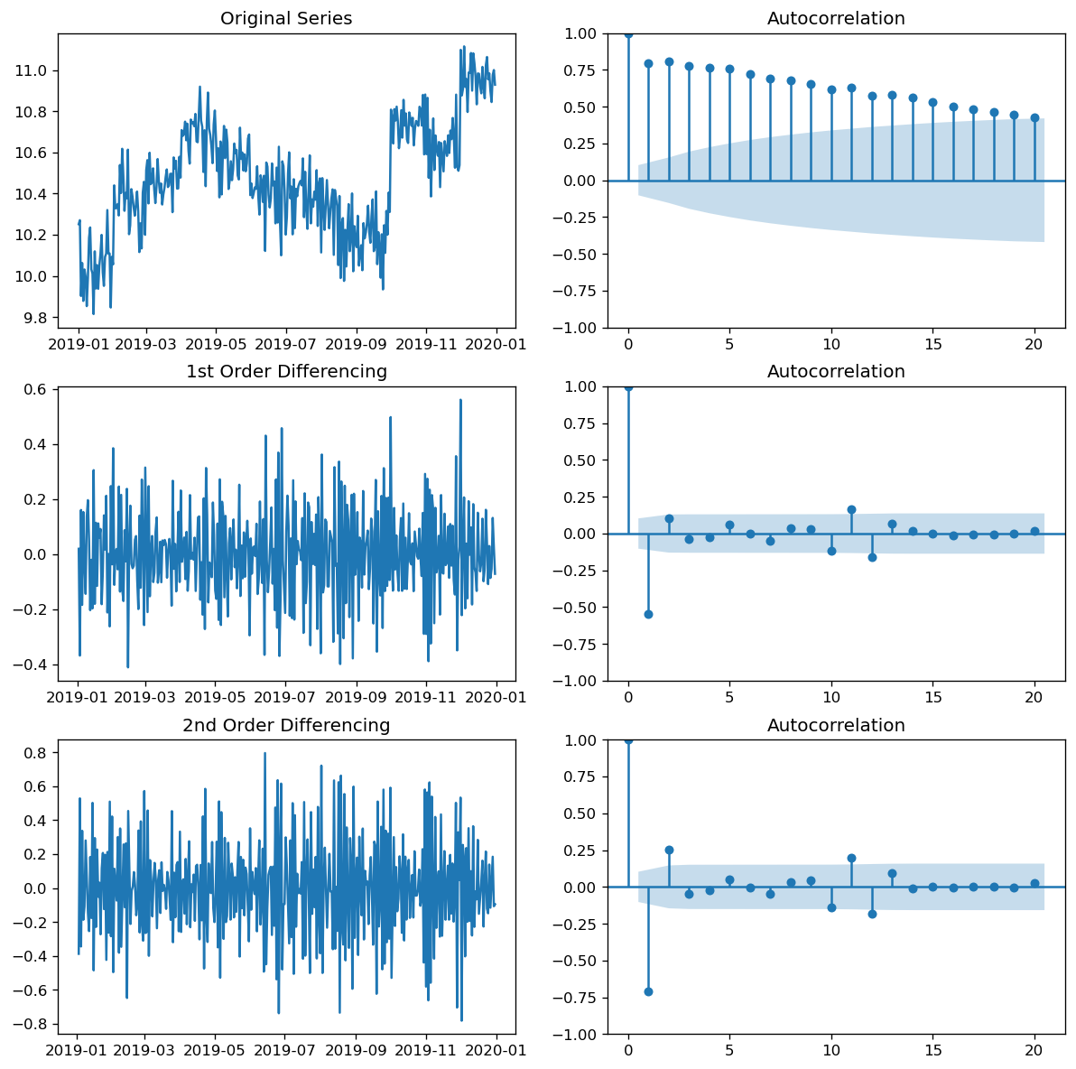
Stationarity
Image 6. Time Series plots and ACF plots to test of high margin subset to test for stationarity

Slide 12
Modeling
Step 1. Determine optimal orders
Auto ARMIA was used to find optimal p, d, and q values
Low margin subset (0, 1, 1 )
High margin subset (1, 1, 1 )
Very high margin subset (0, 1, 2 )
Step 2. Split the data along time
2/3 train and 1/3 test split was made
Split was made along time series such that the test set was the most recent data collected
Step 3. Fit the model and plot predictions against test data set
Step 4. Generate a 30 day forecast
With parameters tuned and tested, the entire dataset was ran through the model to generate profit forecasts for the next 30 days

Slide 13
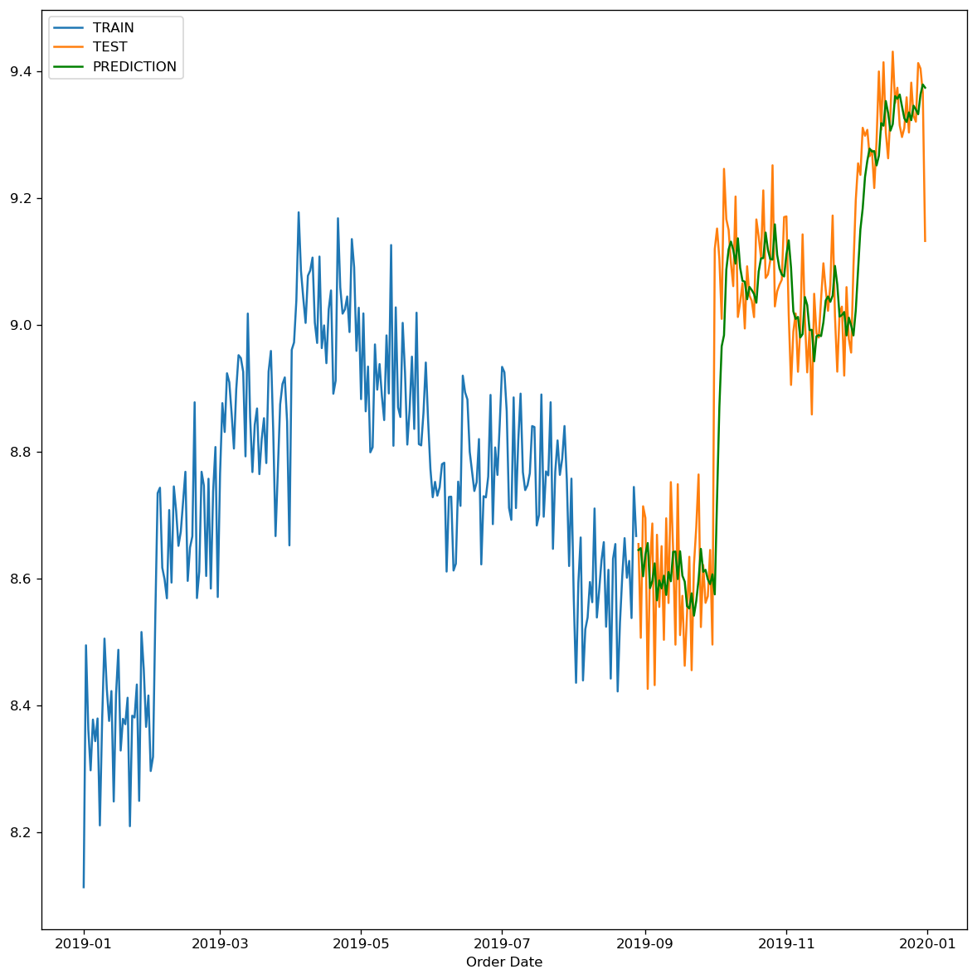
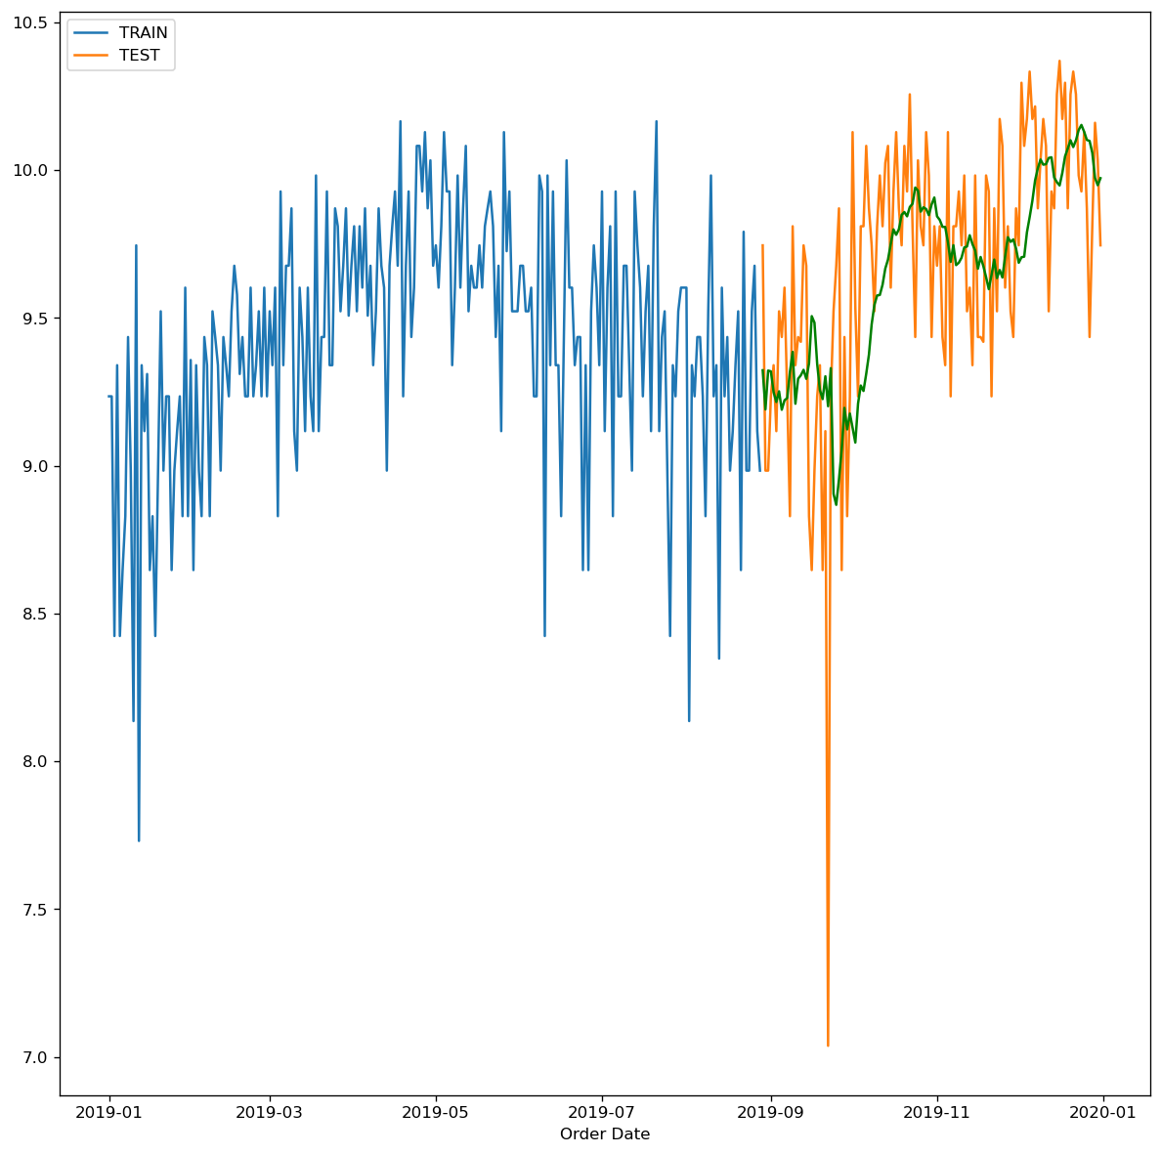
Interpretation
Model predictions were accurate
Low RSME
Low margin subset: 0.112
High margin subset: 0.136
Very high margin subset: 0.392
Image 7. Testing for low margin dataset
Image 8. Testing for very high margin dataset
Image 9. Testing for high margin dataset

Slide 14
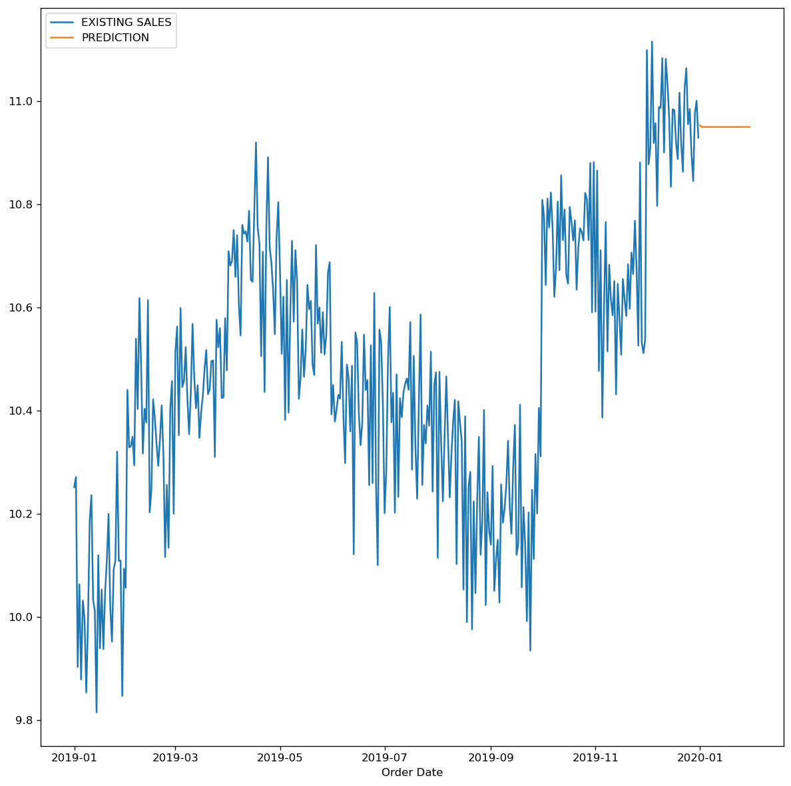
Forecasts
Forecasts predicted a relatively high profit in the near future across all categories
Predicted values tend to level out after 10 days
Image 10. Forecast for high margin dataset

Slide 15
Recommendation
Expanding Product Line
Exploration of expanding the model
Best used as a weekly or daily forecaster
Model Refreshes
Monitoring
Determine any changes needed
Notes:
Our recommendation for the team is to expand the product line. Since we are seeing profitability in every product, there is comfort in adding more products to capture more sales and a larger costumer base. If more resources are allocated to our team, we can look at expanding the model as well. Additionally, we would like to refresh this model and conduct a similar exercise to monitor the trends in sales. With this, the products can be monitored, and if there are any changes in the model patterns, they can be discussed with the team.

Slide 16
Questions?
Frodriguez@my365.bellevue.edu
Cbotts@my365.bellevue.edu
Notes:
This concludes our presentation over Predicting Future Sales of Products. We open the floor to any questions from the group. We have also included our contact information so that you can reach out if any questions come up after this presentation. Thank you all for joining us today! - Felipe

Slide 17
Reference
Beers, B. (2022, September 6). Electronics Sector. Investopedia. https://www.investopedia.com/ask/answers/042915/what-electronics-sector.asp
Cornelius, V. (2023, August 24). Sales Orders. Kaggle. https://www.kaggle.com/datasets/vincentcornlius/sales-orders
Pierre, S. (2022, November 4). A guide to time series forecasting in Python. Built In. https://builtin.com/data-science/time-series-forecasting-python

